Slide 1
NSF CAREER PROPOSAL
Solicitation Number NSF 14-532
Proposal Preparation Tips

Slide 2
Getting Started
Register in NSF Fastlane.
Contact your Grants Specialist (GS) for assistance
Provide your GS: full name, terminal degree type, and terminal degree year
Read the Program Solicitation NSF 14-532
Note any unique requirements
Departmental Letter – 2 pages maximum
Letters of Collaboration, if applicable – 1 page maximum
Note the deadline date – always 5pm proposer’s local time
Monday, July 21st: BIO, CISE, HER
Tuesday, July 22nd: ENG
Wedensday, July 23rd: GEO, MPS, SBE
Inform your GS that you plan to submit a proposal – the sooner the better!
Create a RazorGrant Document
Email the document number (DN) to your GS

Slide 3
Inside NSF Fastlane
Create a temporary proposal number
Allow RSSP (NSF refers to our office as SRO) access to your proposal
Helpful Hint: RSSP has Step-by-step instructions with NSF screen shots (Renee to circulate after meeting via email)

Slide 4
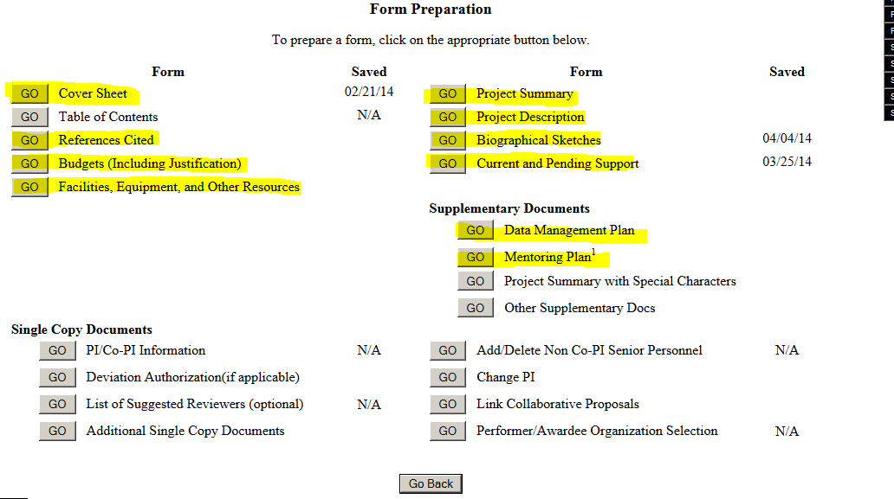
NSF Proposal Parts

Slide 5
BUDGET & BUDGET JUSTIFICATION
 RSSP has a budget template located at http://vpred.uark.edu/250.php
Create your budget here first and share with your Grants Specialist for review
Your Grants Specialist can upload the final RSSP budget into Fastlane
 RSSP has a budget justification template for NSF – ask your GS if you need it
Be realistic – NSF may reduce your budget during negotiations, but they likely will not increase it!
Cost sharing is not permitted
Our current F&A Rate is 46.5% MTDC
Some people speculate that the minimum funding levels stated in the solicitation often reflect the maximum funding level
Later, you can ask for supplements for undergraduates

Slide 6
PROJECT SUMMARY
1 page maximum
4600 character limit
Written in the 3rd person
Three Sections Are Required:
Overview
Intellectual Merit
Broader Impacts
Upload in Supplementary Dox ONLY IF the PS contains special characters

Slide 7
PROJECT SUMMARY: SPECIAL CHARACTERS GUIDANCE
Allowed Characters
[A-Z] [a-z] [0-9] [`~!@#$%^&*()_+=-{},./<>?:;’”|\] Carriage Return Line Feed (CRLF) and Enter -- ASCII Control Characters
Use Project Summary
Special Characters
ä ,ë, ï, ¼, ß, ©, A, ã, ë, µ, ¶, §, etc. Any mathematics symbols Greek letters
Upload Project Summary as a Supplementary Document

Slide 8
SUPPLEMENTARY DOCUMENTS
DATA MANAGEMENT PLAN
DEPARTMENTAL LETTER
A Data Management Plan is required for all proposals which describe your plan for data management and sharing of the products of your project.
POST-DOC MENTORING PLAN
Postdoctoral Researcher Mentoring Plan is required if you request funding for a post-doc.
PI eligibility information. The Departmental Letter, to be included as a supplementary document in the proposal, should state that the PI is eligible to participate in this program.
LETTERS OF COLLABORATION
Postdoctoral Researcher Mentoring Plan is required if you request funding for a post-doc.

Slide 9
SUPPLEMENTARY DOCUMENT: Departmental Letter
1. Departmental Letter (a proposal submitted without this Letter will be returned without review) - In recognition of the teacher-scholar role of beginning faculty members, NSF encourages organizations to value and reward the integration of research and education. This integration of research and education requires close collaboration between the CAREER principal investigator (PI) and his/her organization throughout the duration of the award. To demonstrate the department’s support of the integrated research and education plan of the CAREER awardee, the proposal must include one (and only one) letter from the PI's department head (or equivalent organizational official). If a proposer is in two departments, the letter should be signed by the Department Head in which tenure will be granted. In those cases where tenure is a joint decision, the letter should be signed by both Department Heads. The letter, which will be included as part of the consideration of the overall merits of the proposal, should demonstrate an understanding of, and a commitment to, the effective integration of research and education as a primary objective of the CAREER award. A letter that fails to acknowledge institutional commitment to the professional development and mentoring of the PI in both research and education may disadvantage an otherwise outstanding proposal.
The Departmental Letter should be no more than 2 pages in length, and include the department head's name and title, below the signature. The letter should contain the following elements:
An indication that the PI's proposed CAREER research and education activities are supported by and integrated into the educational and research goals of the department and the organization, and that the department is committed to the support and professional development of the PI;
A description of a) the relationship between the CAREER project, the PI's career goals and job responsibilities, and the goals of his/her department/organization, and b) the ways in which the department head (or equivalent) will ensure the appropriate mentoring of the PI, in the context of the PI's career development and his/her efforts to integrate research and education throughout the period of the award and beyond; and
A statement to the effect that the PI is eligible for the CAREER program.

Slide 10
SUPPLEMENTARY DOCUMENT: Letters of Support
2. Letters of Collaboration - If applicable, the proposal should include short (1 page maximum) letters of collaboration that specify the nature of the collaboration, such as intellectual contributions to the project, permission to access a site, an instrument or facility, offer of samples and materials for research, logistical support to the research and education program, and mentoring of U.S. students at a foreign site. The letter(s) should NOT include a personal endorsement or recommendation of the investigator, but should be limited only to the description of the support that will be offered. The project description should document the nature and need for all collaborations. Requests for letters should be made by the PI well in advance of the proposal submission deadline, because they must be included at the time of submission. Please note that letters of recommendation for the PI are not permitted, and will be removed from the proposal prior to review.

Slide 11
FORMATTING GUIDELINES
NOTE: These requirements apply to all uploaded sections of a proposal, including supplementary documentation:
Use one of the following typefaces identified below:
Arial¹¹, Courier New, or Palatino Linotype at a font size of 10 points or larger;
Times New Roman at a font size of 11 points or larger; or
Computer Modern family of fonts at a font size of 11 points or larger.
A font size of less than 10 points may be used for mathematical formulas or equations, figure, table or diagram captions and when using a Symbol font to insert Greek letters or special characters. PIs are cautioned, however, that the text must still be readable.
No more than six lines of text within a vertical space of one inch.
Margins, in all directions, must be at least an inch
Each section should have page numbers

Slide 12
Handout: NSF CHECKLIST
This concludes the
RSSP NSF 2014 CAREER PRESENTATION
Please contact RSSP with any questions
Call 5-3845 and ask to speak to your Department’s Grants Specialist
The checklist available today on a piece of bright yellow cardstock can serve as a tickler when preparing your 2014 NSF Career Proposal
Note useful web addresses at the bottom of the page

